Slide 1
Test Driving Javascript
Jessie Puls - jpuls@pillartechnology.com
Github - https://github.com/jessiepuls
Twitter - @jessiepuls

Slide 2
Today’s Agenda
General overview
Get into groups & set up
Exercise 1: FizzBuzz
Exercise 2: Sum of digits
Exercise 3: Magic 8-ball
Extra Credit: Something of your own design

Slide 3
What we’ll be using
Jasmine as our testing framework
Karma as our test runner
JQuery because it’s easy to get up and running

Slide 4
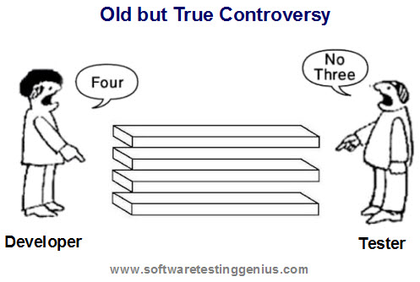
Jasmine: how Do I write tests?
describe("Brief description of our test suite", function () { beforeEach(function() { // set up before each test }); afterEach(function() { // clean something up after each test }); it("Describe the thing you want to test", function () { expect(true).toBe(true); }); });

Slide 5
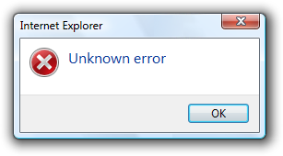
Jasmine: How do I test errors?
describe("Brief description of our test suite", function () { ... it('should throw an exception if not passed a parameter', function () { expect(function(){ someFunction(); })
.toThrow(new Error('Invalid Argument')); }); });

Slide 6
GREAT, SO HOW DO I TEST DRIVE MY CODE?
RED
REFACTOR
GREEN

Slide 7
Ping Pong Pairing
I write a test
You make it pass
Refactor/commit
You write a test
I make it pass
Refactor/Commit

Slide 8
Example: Palindromes
Palindromes are words that are the same forward as they are backward.
Example: madam
Given a string
If string == gnirts return true
If string != gnirts return false
If string is not really a string throw an error
Ignore whitespace while comparing
Ignore capitalization while comparing

Slide 9
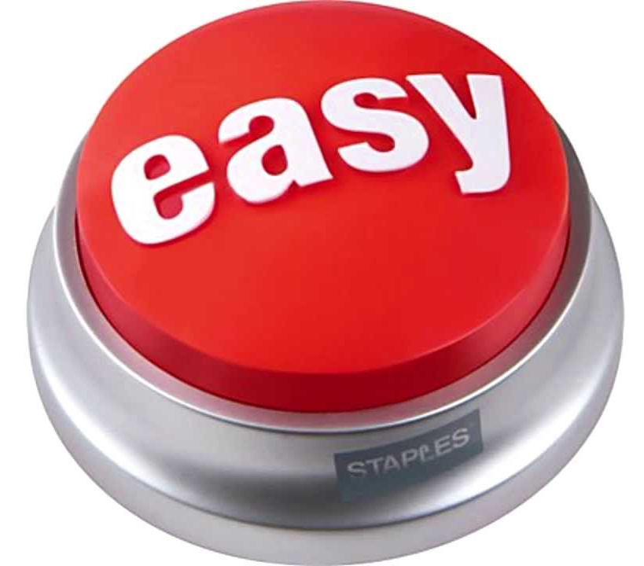
Our first test
it('tacocat is a palindrome', function () { expect(isPalindrome('tacocat')).toBe(true); });
..and make it pass in the easiest way
var isPalindrome = function(inputString) { return true; };

Slide 10
Tricky...Let’s add another test
it('tacodog is not a palindrome', function () { expect(isPalindrome('tacodog')).toBe(false); });
And then write some real code
var isPalindrome = function(inputString) { var reverseString = inputString.split('').reverse().join('');
return reverseString == inputString; };

Slide 11

How about that error case
it('should throw an exception if not passed a string', function () { expect(function(){ isPalindrome(123); }) .toThrow(new Error('Invalid Argument')); });
And the code
var isPalindrome = function(inputString) { if(typeof inputString != 'string') { throw new Error('Invalid Argument'); } var reverseString = inputString.split('').reverse().join(''); return reverseString == inputString; };

Slide 12

Ignore whitespace
it('should ignore whitespace', function() { expect(isPalindrome('taco cat')).toBe(true); });
More code!
var isPalindrome = function(inputString) { if(inputString == undefined) { throw new Error('Invalid Argument'); } var reverseString = inputString.split('').reverse().join('').replace(' ', ''); return reverseString == inputString.replace(' ',''); };

Slide 13
This is getting a little ugly. Let’s try a refactor
var isPalindrome = function(inputString) { if(inputString == undefined) { throw new Error('Invalid Argument'); } var reverseString = inputString.split('').reverse().join('').replace(' ', ''); return reverseString == inputString.replace(' ',''); };

Slide 14
This is a bit more readable, and our tests still pass!
String.prototype.reverse = function() { return this.split('').reverse().join(''); }; String.prototype.removeWhitespace = function() { return this.replace(' ', '') }; String.prototype.isPalindrome = function() { return this.removeWhitespace().reverse() == this.removeWhitespace(); }; var isPalindrome = function(inputString) { if(inputString == undefined) { throw new Error('Invalid Argument'); } return inputString.isPalindrome() };

Slide 15
Okay, let’s keep going. What about tabs & returns?
it('should ignore whitespace', function() { expect(isPalindrome("taco \t\r\ncat")).toBe(true); });
And now we just have to update one place
String.prototype.removeWhitespace = function() { // remember this used to be this: // return this.replace(' ', '') return this.replace(/\s/g, '') };

Slide 16
Last case...ignore capitalization
it('should ignore capitalization', function() { expect(isPalindrome("Taco cat")).toBe(true); });
And we update our comparison
String.prototype.equalsIgnoreCase = function(str) { return this.toLocaleLowerCase() == str.toLowerCase(); }; String.prototype.isPalindrome = function() { return this.removeWhitespace() .reverse() .equalsIgnoreCase(this.removeWhitespace()); };

Slide 17
Let’s get started!
Groups of 2-4 people
Grab a USB drive
Follow the directions in README.md
Get started on exercise one

Slide 18
Exercise One: Fizz Buzz
Given a number:
If it is divisible by 3 output Fizz
If it is divisible by 5 output Buzz
If it is divisible by 3 and 5 output Fizz Buzz
Otherwise output the number
So inputs 1, 2, 3, 4, 5, 15
Create outputs 1, 2, Fizz, 4, Buzz, Fizz Buzz

Slide 19
Exercise Two: Sum of Digits
Given a number
Return the sum of the digits in that number
If non numeric values are input throw an error
Inputs: 1, 12, MOM
Should produce outputs: 1, 3, Invalid Input

Slide 20
How’d it go?

Slide 21
Pulling data from a REST service
We’ll use jasmine-ajax to mock our endpoints, so tests can run frequently without impacting, or relying on outside services
See exampleEndpointMocking.spec.js for reference

Slide 22
Example: Setup
describe('Example endpoint test', function () { beforeEach(function () { jasmine.Ajax.install(); }); afterEach(function () { jasmine.Ajax.uninstall(); }); it('send a GET request to the correct endpoint', function () { ws.exampleEndpointCall('something'); expect(jasmine.Ajax.requests.mostRecent().method).toBe('GET'); expect(jasmine.Ajax.requests.mostRecent().url).toBe(ws.endpoint + 'something'); });
});
This is setup that has to be done for any tests where we want to intercept ajax calls

Slide 23
Example: Faking Responses
describe('Successful requests', function () { it("should set the value on success", function() { spyOn(ws, 'setValue'); ws.exampleEndpointCall('something'); jasmine.Ajax.requests.mostRecent().respondWith({ 'status': 200, 'contentType': 'application/json', 'responseText': '{"data": {"someProperty": "someValue"}}' }); expect(ws.setValue).toHaveBeenCalledWith('someValue'); }); });
Since ajax requests are asynchronous we can send the request after the response has been made

Slide 24
Exercise Three: Magic Eight Ball
Create a webpage that will answer questions with random responses pulled from the rest enpoint provided by https://8ball.delegator.com/
Create a webpage where a user can ask a question that will be answered by the magic 8-ball service.
Make sure you mock the endpoint rather than actually hitting it while you run your tests.
Visually indicate in some way or another if you’ve gotten back an “affirmative” or “contrary” answer.

Slide 25
Exercise Four: Come up with your own idea
Do something fun. Here are a few sources with APIs to get your started, but feel free to do anything.
Star Wars API - https://swapi.co/documentation
Marvel API - http://developer.marvel.com/documentation/getting_started
Brewery DB - http://www.brewerydb.com/developers
Twitter - https://dev.twitter.com/rest/public

Slide 26
Questions?
Jessie Puls - jpuls@pillartechnology.com
Github - https://github.com/jessiepuls
Twitter - @jessiepuls

Slide 27
The End

